Slide 1
Introduction to dataset collection
3Sp recording
11/10/2024 Göteborg

Slide 2
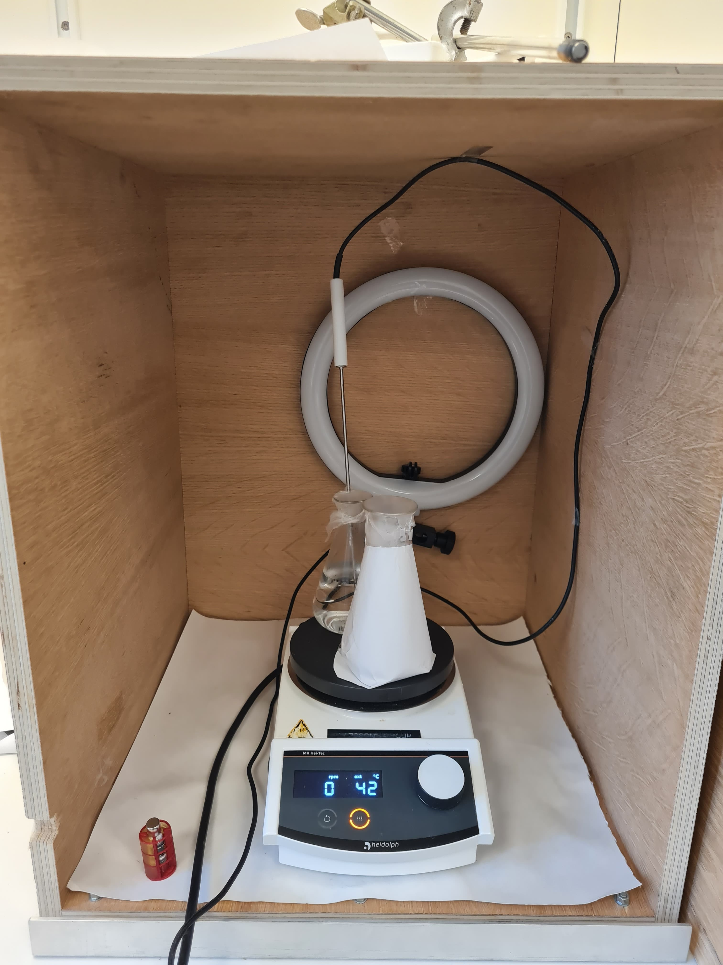
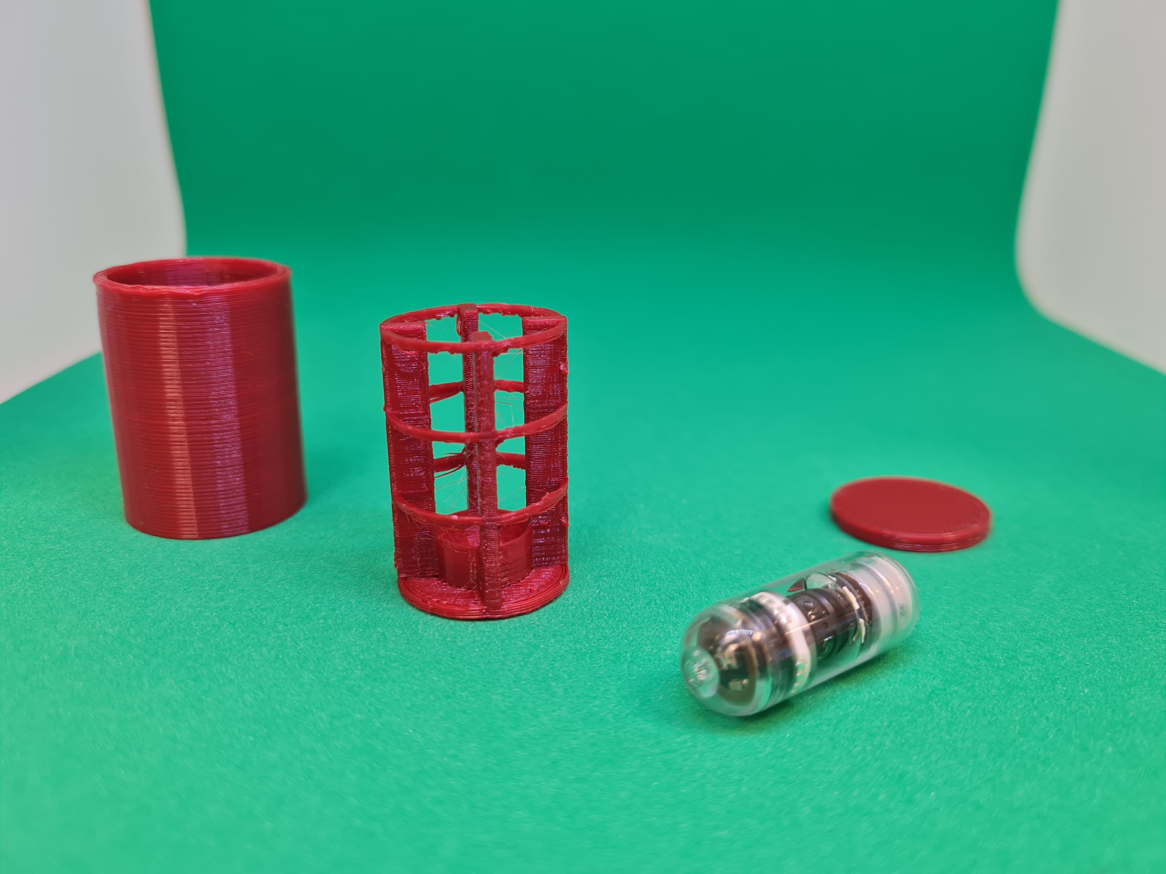
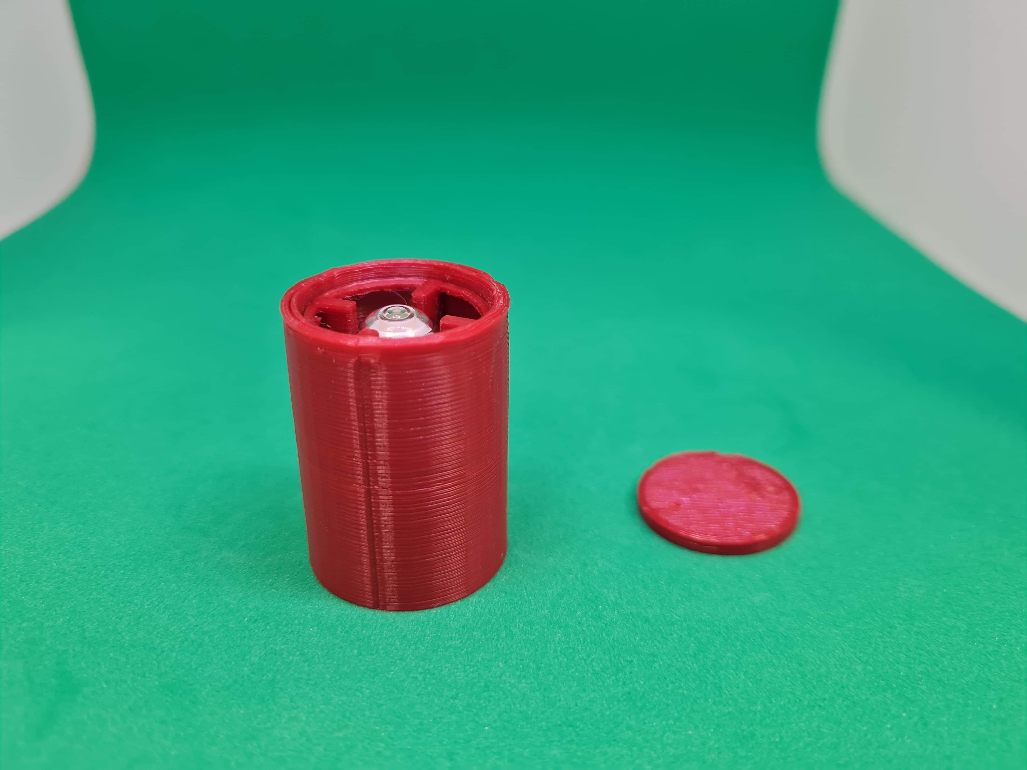

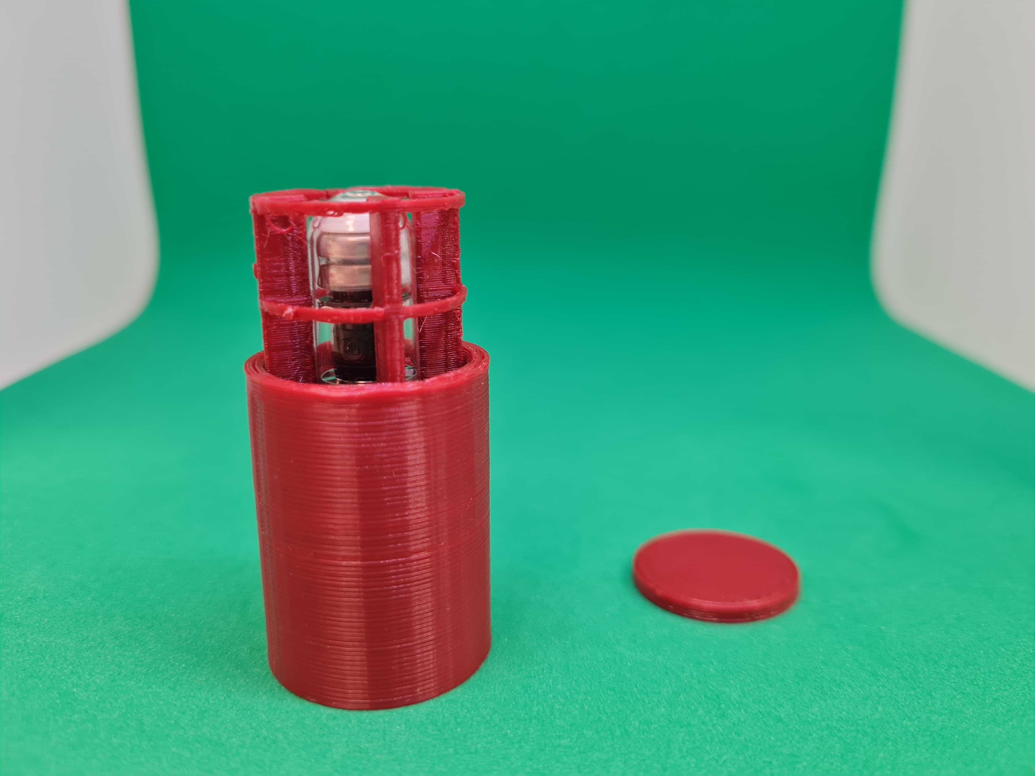
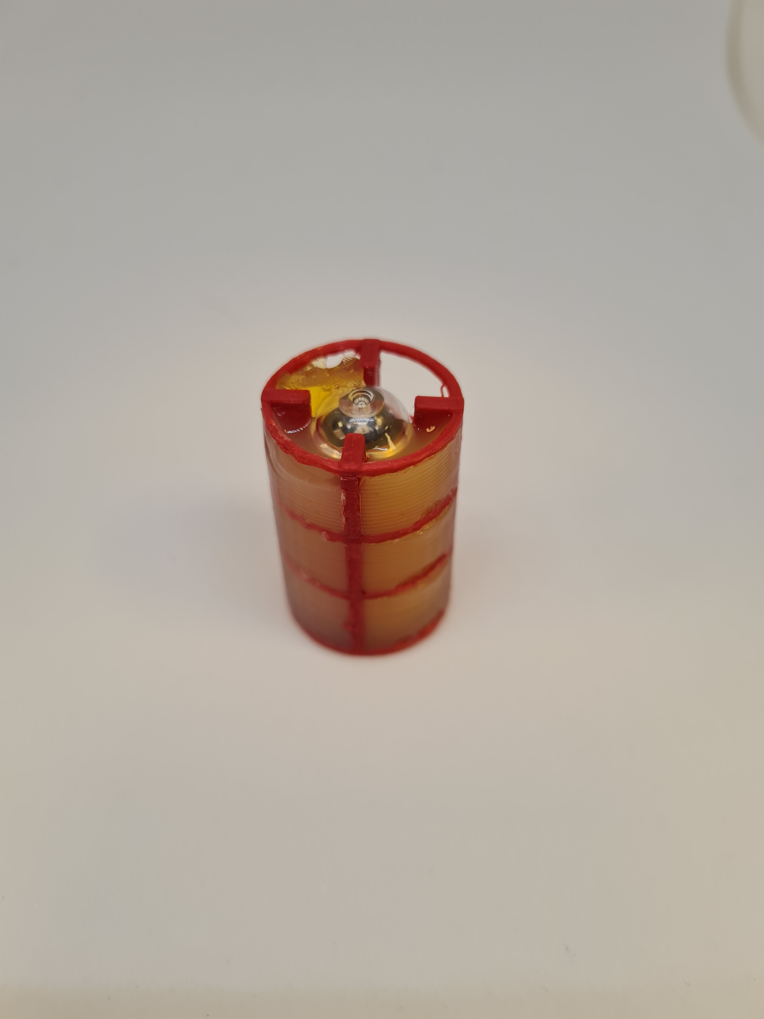
Camera pill recording in Göteborg, October 11th 2024: Gelatin 3%, pH 3, ionic strength 98mM (S=stomach) and pepsin present.
We used a neutral booth and no illumination. The pill was in 250 ml of solution, in a becher wrapped in paper.
Gel casting
250 ml of solution, in a becher wrapped in paper
The same gel was casted in 3 out of 4 sides of the gel mold with the pill inside and let it set overnight
Mold completely dissembled and ready for the casting
Assemblying of the pil and mold. 4 are the cameras and each camera has a mold space in front of itself

Slide 3
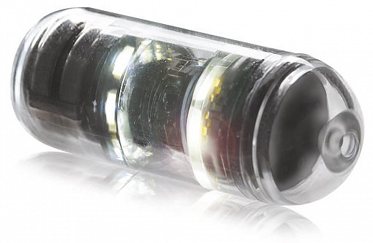
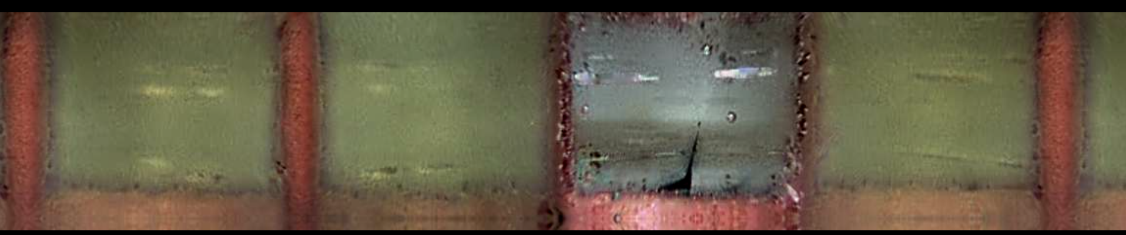
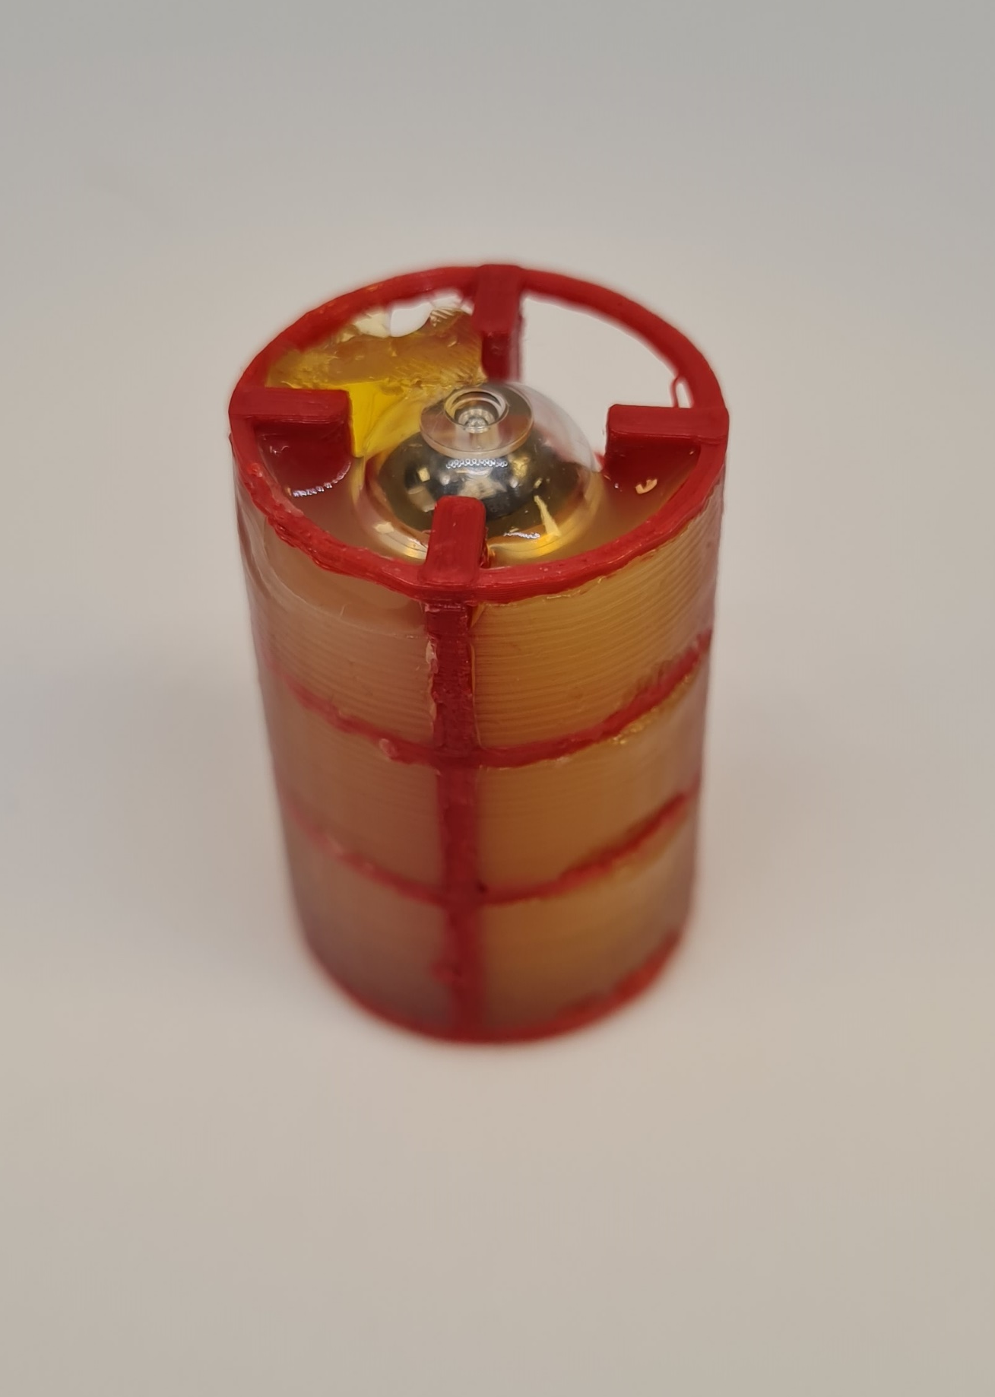
What you observe
2 LED strips that shined during this experiment. There was no other source of light
You can observe bright reflections on the paper behind
Window of the pill not covered by gel for “reference”

Slide 4
What to know
In this recording, the time spacing between frames varies from frame to frame, as the recording speed is determined by the camera physical movement.
When the camera is completely still, as this case, the frames taken are around 1 per 3 minutes
Dividing the length of the video in %, from 0 to 38% you have the start of the recording (neutral booth was open). Around 69% we opened the booth to check inside (brighter for a few frames), and then we recorded from 77 to 93%.
If you want to get the time information, please download and read the video with the software CapsoView (.zip file in this same folder)

